Slide 1
GENDER CONSCIOUS PRACTICE AND YOUTHWORK
Training in Amantea, South of Italy
6 days 27/08/2024 - 1/9/2024

Slide 2
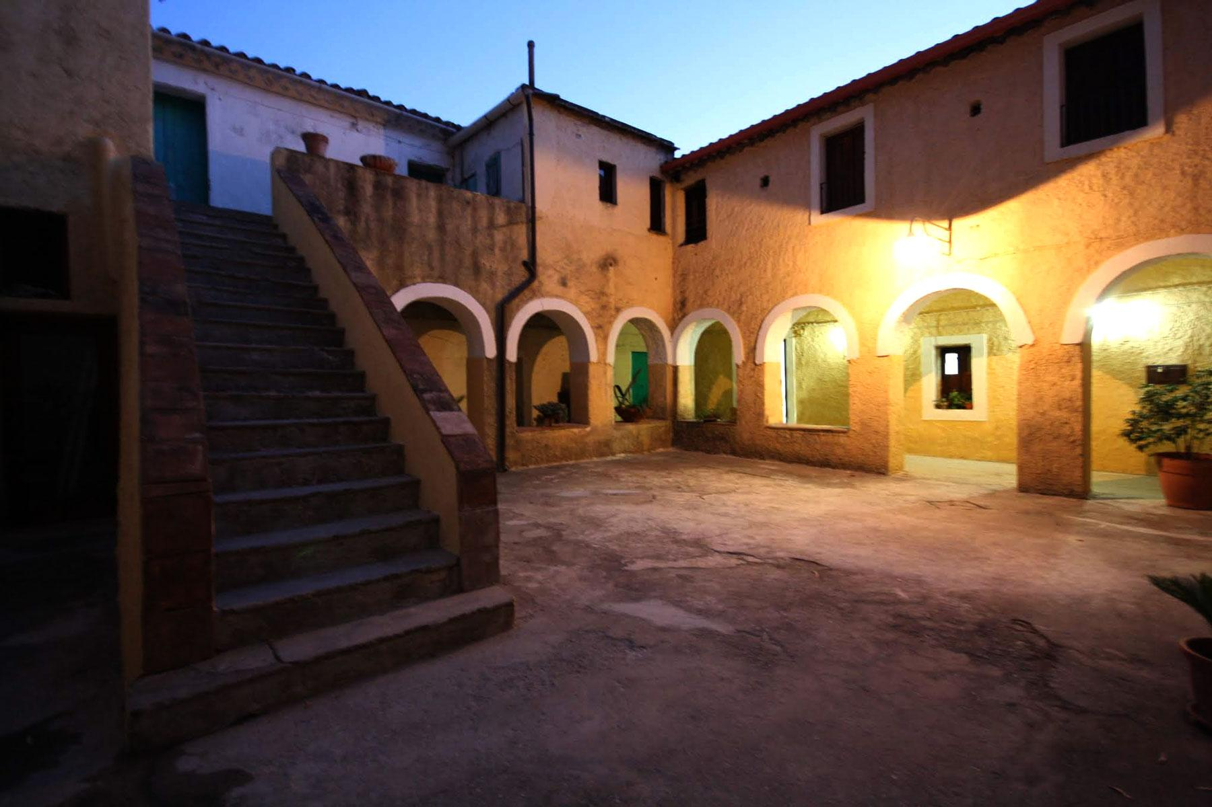
The project aims TO:
-address the increasing phenomenon of gender-based violence and to deliver a more inclusive and active participation in non formal activities.
- Empower women and encouraging their active participation in the society.
Project activities include:
1. mapping the situation in every country and explore effective strategies
2. developing a series of educational activities
3. creation of a tool kit
4. evaluation and dissemination of the results
5. planning future activities.

Slide 3
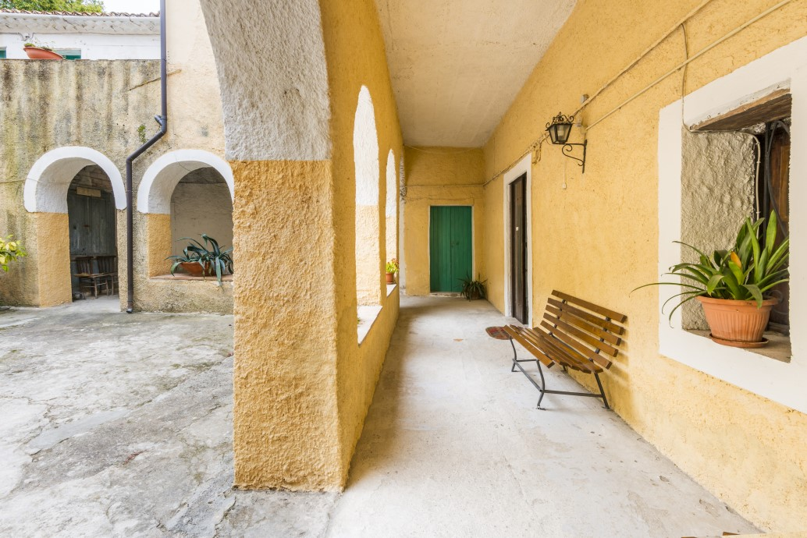
The training is hosted by The Convent Centre of Language & Art - a cultural association and foreign languages school.
Convent Centre promotes activities that empower linguistic and cultural competences.
Daily courses for all ages are delivered, together with workshops for kids and adults that aim to facilitate their approach to foreign languages using non-formal methodologies.
CONVENT CENTRE

Slide 4
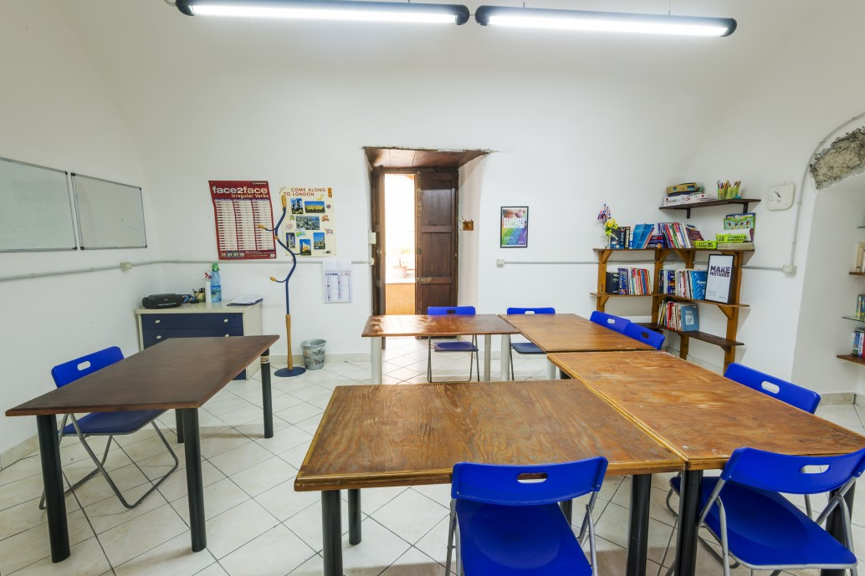
KIT
WHAT WILL YOU DO IN THIS TRAINING?
you will contribute actively in selecting the practices that are in line with the project goals and target audience, offer their insights, knowledge and experience related to the topic
You will contribute to the design process of the validation phase of the selected processes, get inspired from real-life initiatives from Italy that are pioneers in the field.
.
BUT, THE MAIN GOAL OF THIS TRAINING IS TO CREATE THE FIRST DRAFT OF THE TOOL KIT

Slide 5
KIT
THE GOALS OF THE TOOL KIT
1. Offer measurable and tangible actions to prevent, address, and react to incidents of discrimination, gender-based violence, and sexual harassment in youth work activities.
2.Prepare youth workers for addressing discrimination, gender-based violence, and sexual harassment in youth work activities.
3.Improve youth organisations' work culture in terms of gender equality
.
BUT, THE MAIN GOAL OF THIS TRAINING IS TO CREATE THE FIRST DRAFT OF THE TOOL KIT

Slide 6
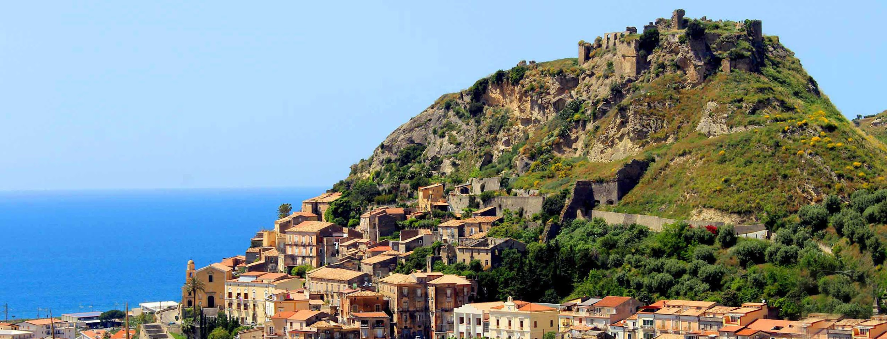
WHERE
Amantea is a charming and sunny town situated in Calabria Region by the Mediterranean Sea.
It is the largest commercial and tourist centre in the area.
There are numerous services and attractions in the town.
AMANTEA (ITALY)

Slide 7
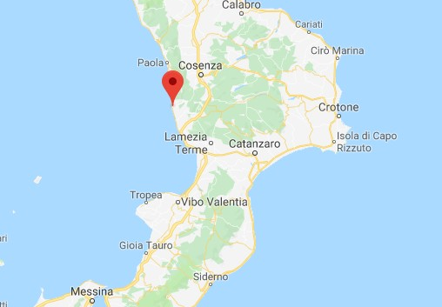
let us know if you need any help with your ticket!
Lamezia “S.Eufemia” International Airport is the closest airport (20 km far away from Amantea.
With Trenitalia you can arrive straight to the city centre.
You can also fly to Rome, Naples or Reggio Calabria and then catch a train/bus/ to Amantea train station.
HOW TO GET TO AMANTEA

Slide 8
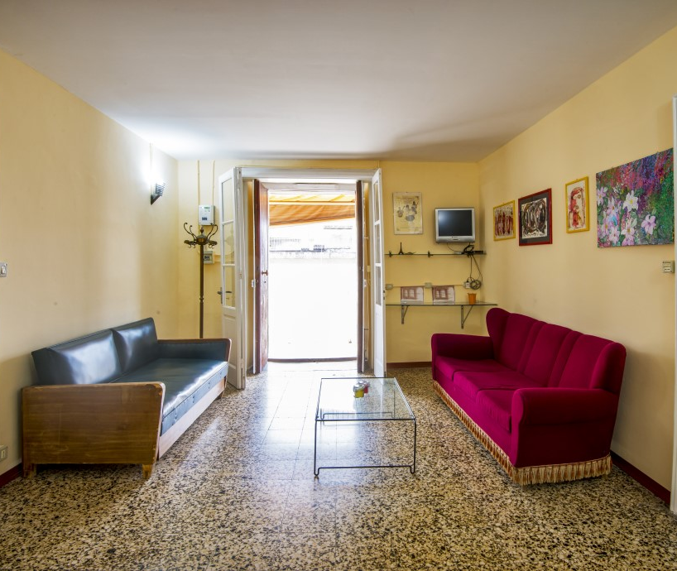
PARTICIPANTS will stay at Casa Convent, a flat located above CONVENT CENTRE in the MAIN SQUARE of the town (Piazza Cappuccini).
The house is fully furnished and there are all the necessary facilities.
ACCOMMODATION

Slide 9
MORE INFORMATION:
Accommodation with all the utilities paid
meals - lunch and dinner paid
Travel refund - contact your Sending Organization
Don't forget your European Health Insurance Card. If you need additional travel insurance, contact your Sending Organization
COSTS OF LIVING

Slide 10
WE CAN’T WAIT TO MEET YOU! For more info: conventcentreamantea@gmail.com
APPLY HERE
Check our Social Media Channel @gender_conscious_youthwork
CLICK - APPLICATION FORM
Notes:
https://forms.gle/j7AWdzboP1V8MVGV8

